Slide 1

Solving System of Linear Equations
Notes:
Textbook: Chapter 1.3, 1.4
=========
http://www.mathconcentration.com/profiles/blogs/real-world-application-of-solving-equations
Examples

Slide 2

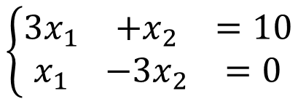
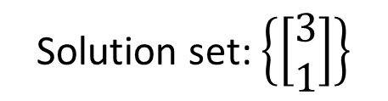
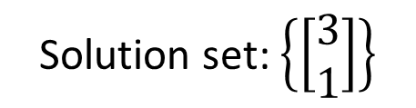
Equivalent
Two systems of linear equations are equivalent if they have exactly the same solution set.
$$\left\{\begin{matrix}\begin{matrix}3x_{1} & +x_{2} & =10\end{matrix} \\ \begin{matrix}x_{1} & −3x_{2} & =0\end{matrix}\end{matrix}\right.$$
$$\left\{\begin{matrix}\begin{matrix}x_{1} & & =3\end{matrix} \\ \begin{matrix} & x_{2} & =1\end{matrix}\end{matrix}\right.$$
Solution set: $\left\{\left[\begin{matrix}3 \\ 1\end{matrix}\right]\right\}$
equivalent
Solution set: $\left\{\left[\begin{matrix}3 \\ 1\end{matrix}\right]\right\}$

Slide 3
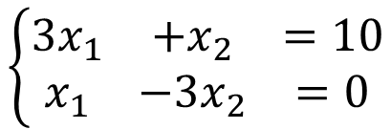
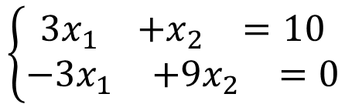
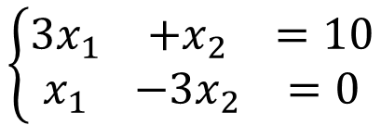
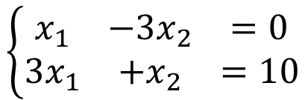
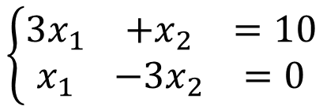

Equivalent
Applying the following three operations on a system of linear equations will produce an equivalent one.
1. Interchange
2. Scaling
3. Row Addition
$$\left\{\begin{matrix}\begin{matrix}3x_{1} & +x_{2} & =10\end{matrix} \\ \begin{matrix}x_{1} & −3x_{2} & =0\end{matrix}\end{matrix}\right.$$
$$\left\{\begin{matrix}\begin{matrix}x_{1} & −3x_{2} & =0\end{matrix} \\ \begin{matrix}3x_{1} & +x_{2} & =10\end{matrix}\end{matrix}\right.$$
(non zero)
$$\left\{\begin{matrix}\begin{matrix}3x_{1} & +x_{2} & =10\end{matrix} \\ \begin{matrix}x_{1} & −3x_{2} & =0\end{matrix}\end{matrix}\right.$$
$$\left\{\begin{matrix}\begin{matrix}3x_{1} & +x_{2} & =10\end{matrix} \\ \begin{matrix}−3x_{1} & +9x_{2} & =0\end{matrix}\end{matrix}\right.$$
X(-3)
$$\left\{\begin{matrix}\begin{matrix}3x_{1} & +x_{2} & =10\end{matrix} \\ \begin{matrix}x_{1} & −3x_{2} & =0\end{matrix}\end{matrix}\right.$$
$$\left\{\begin{matrix}\begin{matrix} & 10x_{2} & =10\end{matrix} \\ \begin{matrix}x_{1} & −3x_{2} & =0\end{matrix}\end{matrix}\right.$$
X(-3)
Notes:
Simple operations defined on a system of linear equations
not change the solution set of the system of linear equations
They are all equivalent.
Used for solving systems of linear equations
Equivalent systems of linear equations: having the same solution set.
An elementary row operation taken on a system of linear equations will result in another equivalent system of linear equations
Elementary row operations for solving systems of linear equations:

Slide 4
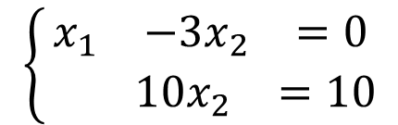
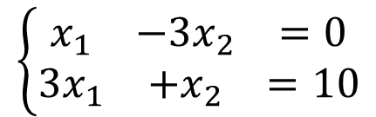
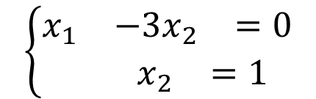
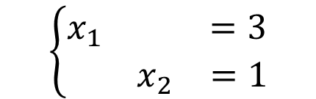
Solving system of linear equation
Strategy
We know how to transform the given system of linear equations into another equivalent one.
We do it again and again until the system of linear equation is very simple
Finally, we know the answer at a glance.
$$\left\{\begin{matrix}\begin{matrix}x_{1} & −3x_{2} & =0\end{matrix} \\ \begin{matrix}{3x}_{1} & +x_{2} & =10\end{matrix}\end{matrix}\right.$$
X 3
$$\left\{\begin{matrix}\begin{matrix}x_{1} & −3x_{2} & =0\end{matrix} \\ \begin{matrix} & 10x_{2} & =10\end{matrix}\end{matrix}\right.$$
X 1/10
$$\left\{\begin{matrix}\begin{matrix}x_{1} & & =3\end{matrix} \\ \begin{matrix} & x_{2} & =1\end{matrix}\end{matrix}\right.$$
$$\left\{\begin{matrix}\begin{matrix}x_{1} & −3x_{2} & =0\end{matrix} \\ \begin{matrix} & x_{2} & =1\end{matrix}\end{matrix}\right.$$
X 3

Slide 5
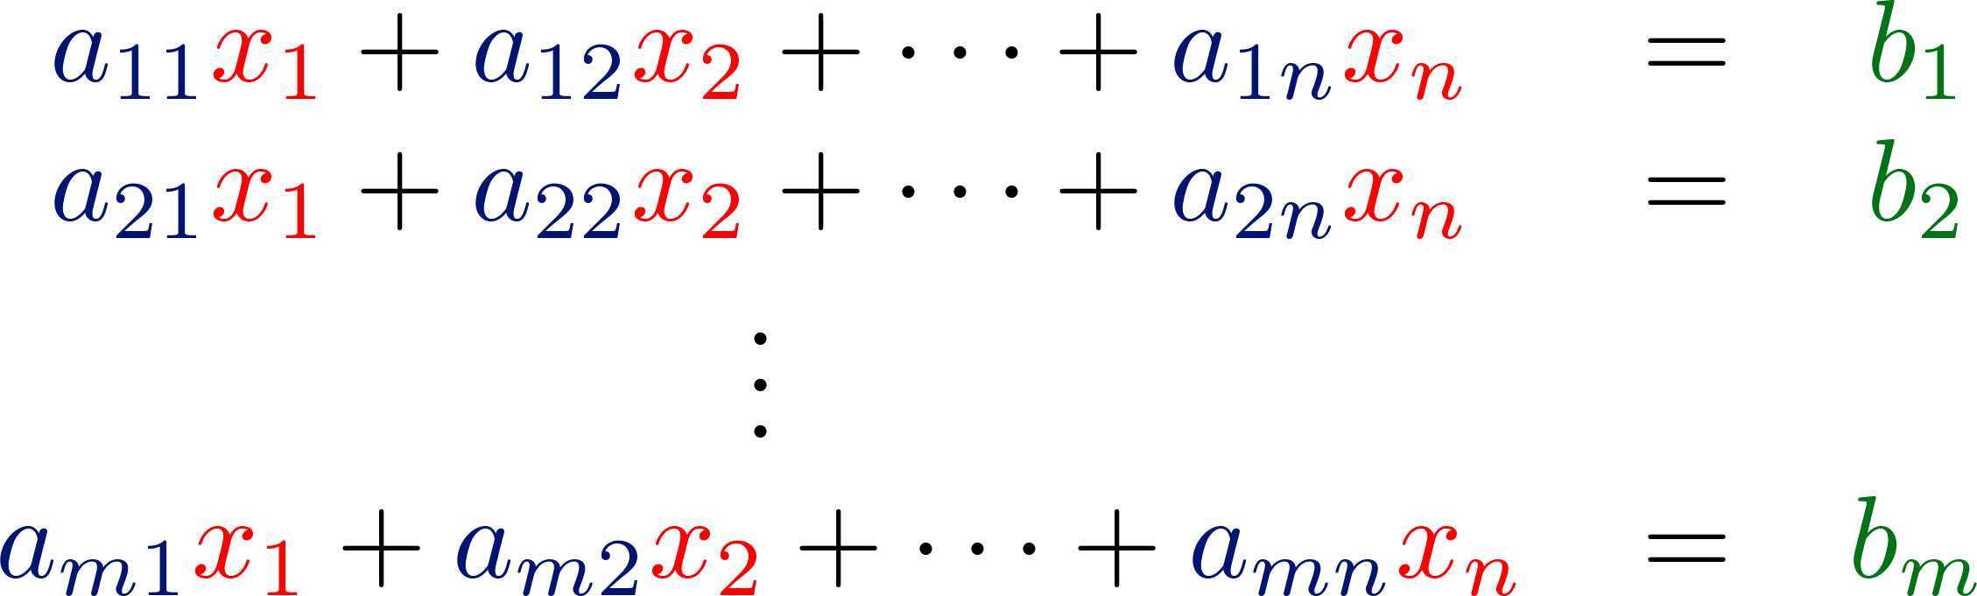




Augmented Matrix
a system of linear equation
$$A=\left[\begin{matrix}\begin{matrix}a_{11} & a_{12} \\ a_{21} & a_{22}\end{matrix} & \begin{matrix}⋯ & a_{1n} \\ ⋯ & a_{2n}\end{matrix} \\ \begin{matrix}⋮ & ⋮ \\ a_{m1} & a_{m2}\end{matrix} & \begin{matrix}⋱ & ⋮ \\ ⋯ & a_{mn}\end{matrix}\end{matrix}\right]$$
$$x=\left[\begin{matrix}\begin{matrix}x_{1} \\ x_{2}\end{matrix} \\ \begin{matrix}⋮ \\ x_{n}\end{matrix}\end{matrix}\right]$$
$$b=\left[\begin{matrix}\begin{matrix}b_{1} \\ b_{2}\end{matrix} \\ \begin{matrix}⋮ \\ b_{m}\end{matrix}\end{matrix}\right]$$
m x n
coefficient matrix

Slide 6
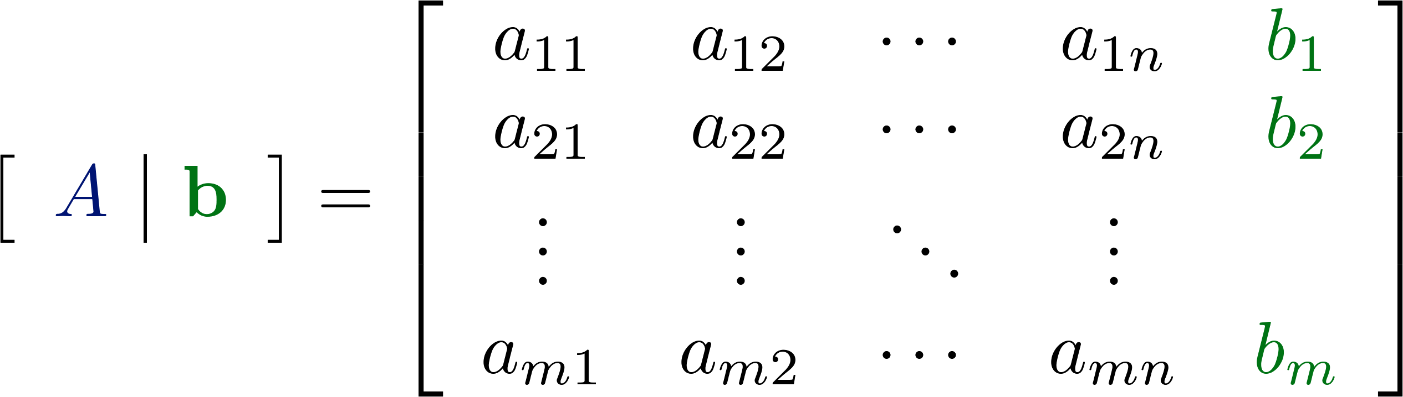
Augmented Matrix
a system of linear equation
m x (n+1)
m x n
m x 1
augmented matrix

Slide 7
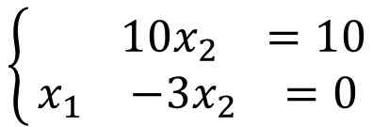
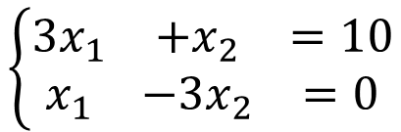
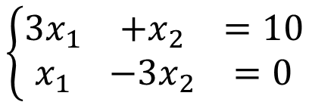
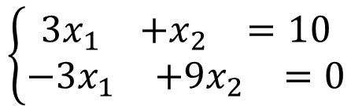
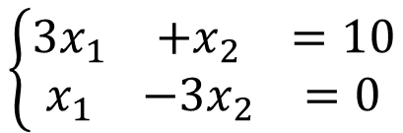
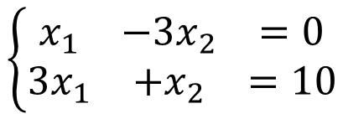
Back to Equivalent
1. Interchange
2. Scaling
3. Row Addition
$$\left\{\begin{matrix}\begin{matrix}3x_{1} & +x_{2} & =10\end{matrix} \\ \begin{matrix}x_{1} & −3x_{2} & =0\end{matrix}\end{matrix}\right.$$
$$\left\{\begin{matrix}\begin{matrix}x_{1} & −3x_{2} & =0\end{matrix} \\ \begin{matrix}3x_{1} & +x_{2} & =10\end{matrix}\end{matrix}\right.$$
(non zero)
$$\left\{\begin{matrix}\begin{matrix}3x_{1} & +x_{2} & =10\end{matrix} \\ \begin{matrix}x_{1} & −3x_{2} & =0\end{matrix}\end{matrix}\right.$$
$$\left\{\begin{matrix}\begin{matrix}3x_{1} & +x_{2} & =10\end{matrix} \\ \begin{matrix}−3x_{1} & +9x_{2} & =0\end{matrix}\end{matrix}\right.$$
X(-3)
$$\left\{\begin{matrix}\begin{matrix}3x_{1} & +x_{2} & =10\end{matrix} \\ \begin{matrix}x_{1} & −3x_{2} & =0\end{matrix}\end{matrix}\right.$$
$$\left\{\begin{matrix}\begin{matrix} & 10x_{2} & =10\end{matrix} \\ \begin{matrix}x_{1} & −3x_{2} & =0\end{matrix}\end{matrix}\right.$$
X(-3)
Notes:
Simple operations defined on a system of linear equations
not change the solution set of the system of linear equations
They are all equivalent.
Used for solving systems of linear equations
Equivalent systems of linear equations: having the same solution set.
An elementary row operation taken on a system of linear equations will result in another equivalent system of linear equations
Elementary row operations for solving systems of linear equations:

Slide 8
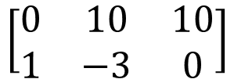
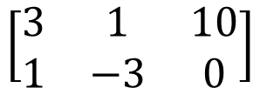
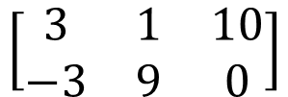
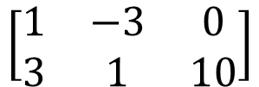
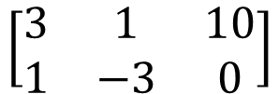
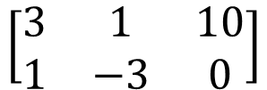
Back to Equivalent
elementary row operations
Interchange any two rows of the matrix
1. Interchange
2. Scaling
3. Row Addition
$$\left[\begin{matrix}3 & 1 & 10 \\ 1 & −3 & 0\end{matrix}\right]$$
$$\left[\begin{matrix}1 & −3 & 0 \\ 3 & 1 & 10\end{matrix}\right]$$
(non zero)
Multiply every entry of some row by the same nonzero scalar
$$\left[\begin{matrix}3 & 1 & 10 \\ 1 & −3 & 0\end{matrix}\right]$$
$$\left[\begin{matrix}3 & 1 & 10 \\ −3 & 9 & 0\end{matrix}\right]$$
X(-3)
Add a multiple of one row of the matrix to another row
$$\left[\begin{matrix}3 & 1 & 10 \\ 1 & −3 & 0\end{matrix}\right]$$
$$\left[\begin{matrix}0 & 10 & 10 \\ 1 & −3 & 0\end{matrix}\right]$$
X(-3)
Notes:
Simple operations defined on a system of linear equations
not change the solution set of the system of linear equations
They are all equivalent.
Used for solving systems of linear equations
Equivalent systems of linear equations: having the same solution set.
An elementary row operation taken on a system of linear equations will result in another equivalent system of linear equations
Elementary row operations for solving systems of linear equations:

Slide 9
Solving system of linear equation
A complex system of linear equations
A simple system of linear equations
Ax = b
R′x = b′
equivalent
A’=[ A b ]
A’’
A’’’
……
R=[ R′ b′ ]
elementary row operations
1. Interchange any two rows of the matrix
2. Multiply every entry of some row by the same nonzero scalar
3. Add a multiple of one row of the matrix to another row
Notes:
Every elementary row operations are reversible.
For interchange operation it is obvious, for scaling operation
multiply the inverse of the nonzero constant, and for row addition
operation add the negative multiple of the row to the other row.

Slide 10
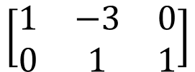
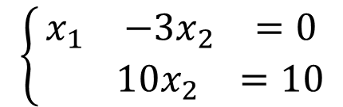
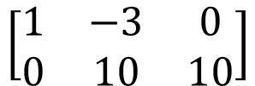
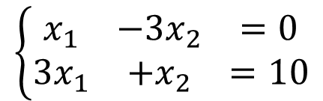
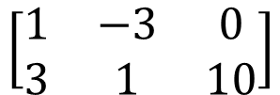
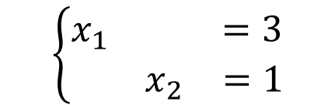
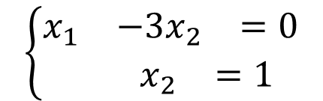
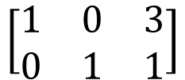
$$\left\{\begin{matrix}\begin{matrix}x_{1} & −3x_{2} & =0\end{matrix} \\ \begin{matrix}{3x}_{1} & +x_{2} & =10\end{matrix}\end{matrix}\right.$$
X 3
X 3
$$\left[\begin{matrix}1 & −3 & 0 \\ 3 & 1 & 10\end{matrix}\right]$$
$$\left\{\begin{matrix}\begin{matrix}x_{1} & −3x_{2} & =0\end{matrix} \\ \begin{matrix} & 10x_{2} & =10\end{matrix}\end{matrix}\right.$$
$$\left[\begin{matrix}1 & −3 & 0 \\ 0 & 10 & 10\end{matrix}\right]$$
X 1/10
X 1/10
$$\left\{\begin{matrix}\begin{matrix}x_{1} & −3x_{2} & =0\end{matrix} \\ \begin{matrix} & x_{2} & =1\end{matrix}\end{matrix}\right.$$
$$\left[\begin{matrix}1 & −3 & 0 \\ 0 & 1 & 1\end{matrix}\right]$$
X 3
X 3
$$\left\{\begin{matrix}\begin{matrix}x_{1} & & =3\end{matrix} \\ \begin{matrix} & x_{2} & =1\end{matrix}\end{matrix}\right.$$
$$\left[\begin{matrix}1 & 0 & 3 \\ 0 & 1 & 1\end{matrix}\right]$$

Slide 11
Solving system of linear equation
A complex system of linear equations
A simple system of linear equations
?????
Ax = b
R′x = b′
equivalent
A’=[ A b ]
A’’
A’’’
……
R=[ R′ b′ ]
Reduced Row Echelon Form (RREF)
elementary row operations:
1. Interchange any two rows of the matrix
2. Multiply every entry of some row by the same nonzero scalar
3. Add a multiple of one row of the matrix to another row
Notes:
Every elementary row operations are reversible.
For interchange operation it is obvious, for scaling operation
multiply the inverse of the nonzero constant, and for row addition
operation add the negative multiple of the row to the other row.

